Slide 2
Pumping Lemma Test
Pumping Lemma Test
Pass
No conclusion,
May be regular or not
Language
Fail
Not Regular

Slide 3
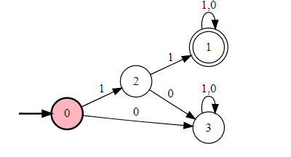
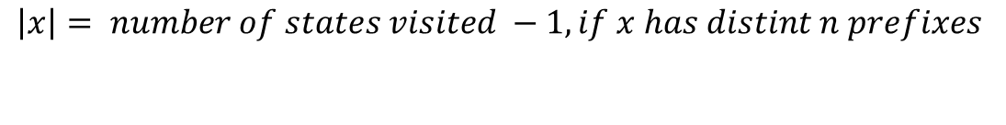
What is pumping Length??
Distinct prefix means no prefix can be lambda.
Number of states visited to read a word is called as pumping length.
$$\left|x\right|= number of states visited −1, if x has distint n prefixes$$
$$\left|x\right|≥n, by this time we can say that , while reading symbols of x$$
$$we must visit have visited some state more that once.$$

Slide 4
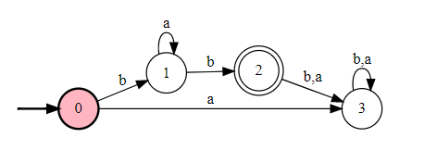

Slide 5
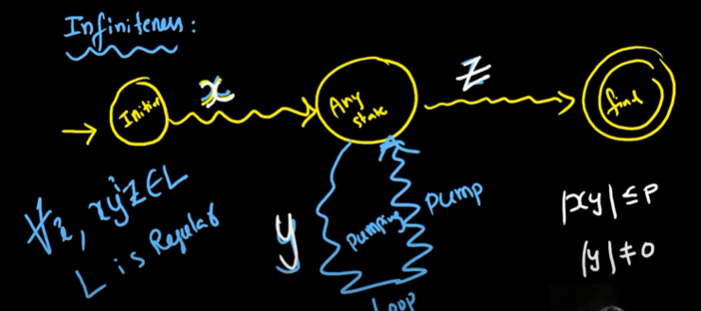

Slide 6
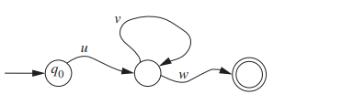

Slide 7
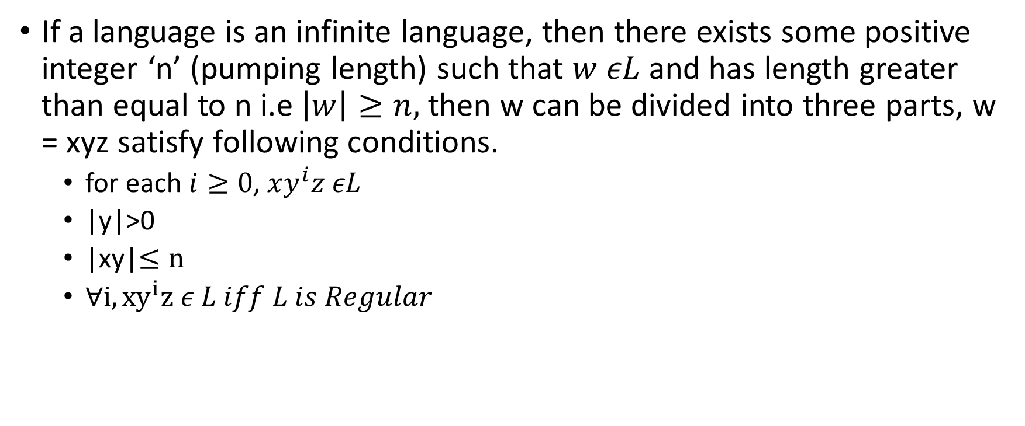
Pumping Lemma Test
If a language is an infinite language, then there exists some positive integer ‘n’ (pumping length) such that $w εL$ and has length greater than equal to n i.e $\left|w\right|≥n,$then w can be divided into three parts, w = xyz satisfy following conditions.
for each $i≥0$, $xy^{i}z εL$
|y|>0
|xy|$≤n$
$∀i, {xy}^{i}z ε L iff L is Regular$

Slide 8
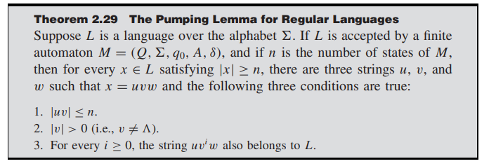

Slide 9



$a^{n}b^{n}$
$a^{n}b^{2n}$
$a^{p}, where p is prime$
Palindrome?
$L=\{x ε{\left\{a,b\right\}}^{∗} |n_{a}\left(x\right)>n_{b}\left(x\right)\}$
${a^{i}}^{2}$
Take the case of $a^{n}ba^{n}$
Take the case of $a^{2n}b^{n}$

